Slide 1
Chapter 5
Stereotypes, Prejudice, and Discrimination

Slide 2
Defining Our Terms
Racism
  Prejudice and discrimination based on a person’s racial background
Sexism
  Prejudice and discrimination based on a person’s gender
Both can be individual or institutional/cultural practices

Slide 3
Defining Our Terms
Stereotypes
  A belief or association that links a whole group of people with certain traits or characteristics.
  Prejudice
  Negative feelings about others because of their connection to a social group.
Discrimination
  Concerns behaviors—specifically, negative behaviors directed against persons because of their membership in a particular group.

Slide 4
Racism: Current Forms and Challenges
Research indicates that racial prejudice and discrimination have been decreasing in the United States and in many other countries over the past many decades.
Doesn’t mean its not still a problem

Slide 5
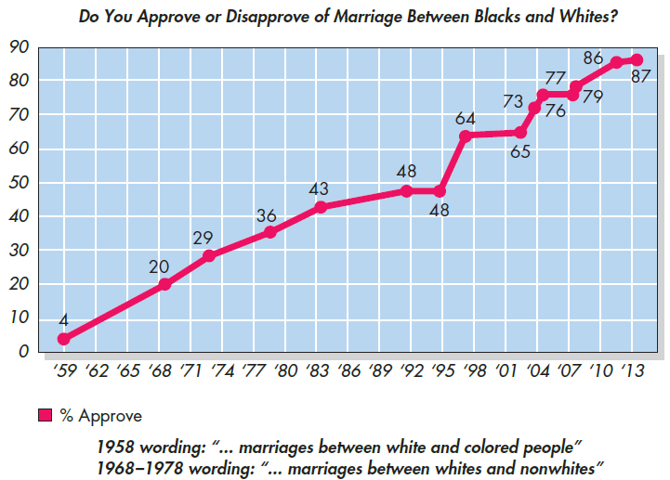
Notes:
Figure 5.2 Changes in Attitudes Toward Interracial Marriage
Sources: Moberg et al. (2019); Newport (2015).

Slide 6
Measuring Implicit Racism
We typically think of racism as overt or deliberate, but it doesn’t have to be
Implicit racism
  Racism that operates unconsciously and unintentionally
Subtle, indirect methods are used to measure individuals’ degree of implicit racism.
Implicit Association Test (IAT), first developed and tested by Anthony Greenwald and others. (1998)

Slide 7
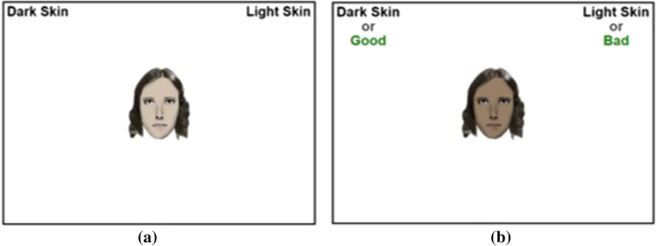
Implicit Association Test
https://implicit.harvard.edu/implicit/takeatest.html

Slide 8
Implicit Association Test
Potential Problems:
  Validity: Can we really measure something an individual isn’t consciously aware of?
  Reliability: Same person can take the IAT multiple times and receive different scores

Slide 9
Implicit Association Test
Potential Problems:
  Scoring: Classic IAT uses a score returns a score between -2 and 2
  .65 (or -.65) is the “cut-off”
    Example: Score of > .65 == strong association between “European-Americans” and “good”
    No study has found differences in discriminatory behaviors based on IAT scores

Slide 10
Interracial Interactions
Individuals engaging in intergroup interactions often:
  Activate metastereotypes
  Worry about being seen as consistent with these stereotypes
People sometimes try to avoid interracial interaction for fear of:
  Appearing racist
  Being treated in a racist way

Slide 11
Sexism
Blatant displays of sexism are less socially acceptable than in the past but they do continue to exist at a frequency and with an intensity that would surprise many.
Gender stereotypes are distinct in that:
  They often are prescriptive, rather than merely descriptive
  Beliefs about what men and women should be like, not how they actually are

Slide 12
Sexism
There are two types:
Hostile sexism
  Hostile sexism: characterized by negative, resentful feelings about women’s abilities, value, and challenge to men’s power
Benevolent sexism
  Benevolent sexism: characterized by affectionate, chivalrous feelings founded on the potentially patronizing belief that women need and deserve protection

Slide 13
Gender Discrimination: Double Standards and Pervasive Stereotypes
Sex discrimination continues to exist in numerous other ways.
In many parts of the world, blatant sexism not only is still quite evident but even is the law of the land.
Sex discrimination during the early school years may pave the way for diverging career paths in adulthood.

Slide 14
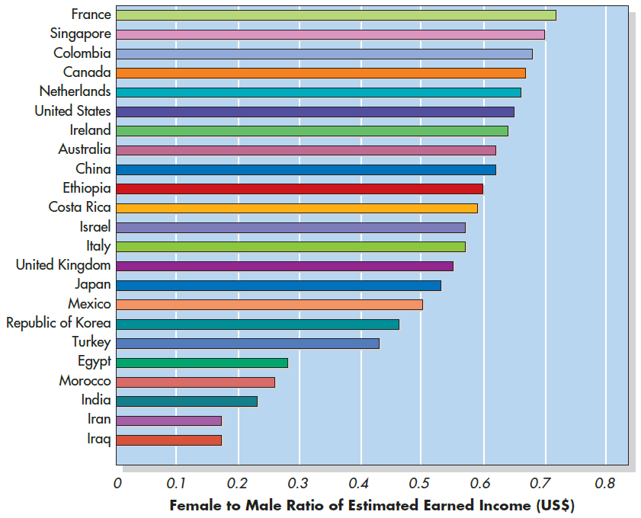
World Economic Forum (2018)
Notes:
Figure 5.7 Gender Ratio in Income in Selected Countries Around the World These international labor statistics show the female-to-male ratio of earned income in each of a variety of countries around the world. The smaller the bar, the less income women earn compared to men in the country. Source: World Economic Forum (2018)

Slide 15
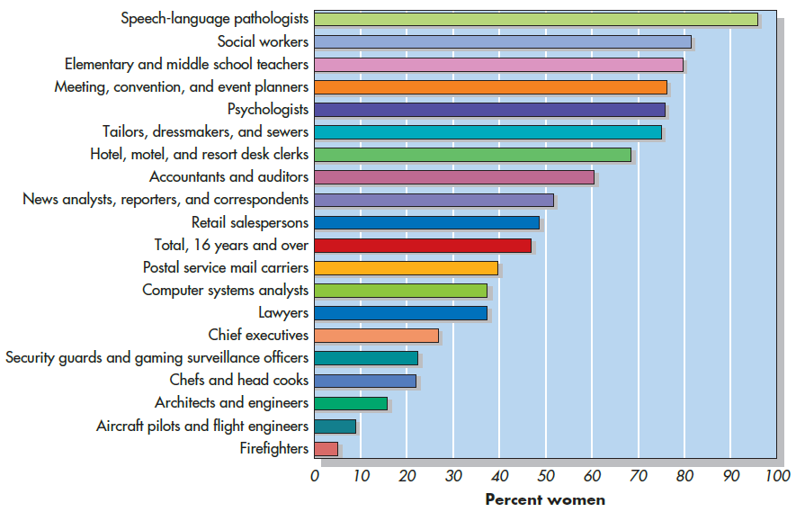
U.S. Bureau of Labor Statistics (2018)
Notes:
Figure 5.6 Percentage of Women in Specific Occupations in the United States, 2018

Slide 16
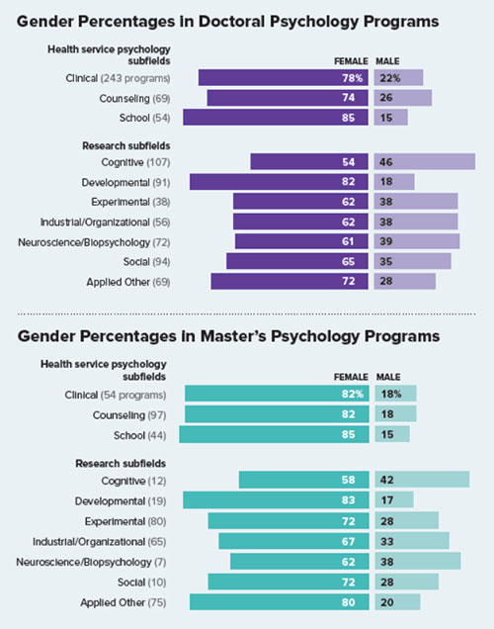
APA (2018)

Slide 17
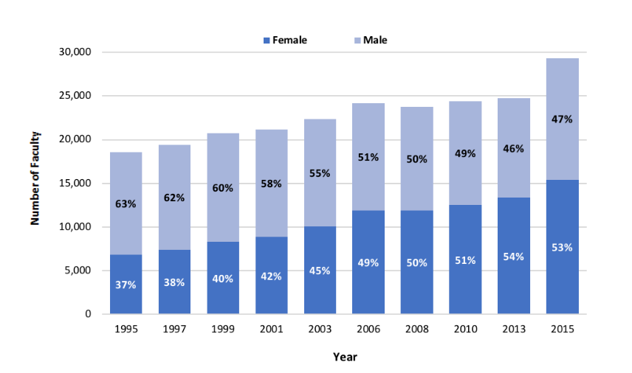
Who gets doctorates in psych?
APA (2019)

Slide 18
Gender Gap in Psychological Research?
Odic & Wojcik (2020):
  Analyzed publication records from 125 high-impact journals
  Found that female psychologists published less and were less cited vs. male counterparts (within same subfields)
    Biggest difference in neuroscience, Cognitive, and Quantitative
    Smallest difference in Health and Development

Slide 19
Culture and Sexism
Gender stereotypes are remarkably consistent around the world, and sexism remains pervasive as well.
Support for the idea of gender equality is beginning to grow around the world.
  A more serious example comes from a study by David Schwegman (2019). He contacted property owners who advertised rental units from 94 cities around the United States.

Slide 20
Culture and Sexism
  Schwegman e-mailed the owners to indicate interest in renting the property, and through random assignment he used either a male or a female name, along with the name of his or her spouse. If this e-mail indicated that the requester had a same-sex spouse, the owners were less likely to respond than if the e-mail suggested a heterosexual couple. The owners were especially likely to ignore the rental request if the e-mail suggested that it came from a black man with a husband.

Slide 21
Beyond Racism and Sexism: Age, Weight, Sexuality, and Intersectionality (1 of 2)
Researchers are focusing more attention today on other forms of discrimination as well, including those targeting people’s
  Physical disabilities or disfigurements
  Mental health
  Political ideology
  Economic class
  Weight
  Being unmarried
  Religion

Slide 22
Beyond Racism and Sexism: Age, Weight, Sexuality, and Intersectionality (2 of 2)
Rapidly growing body of research studying the intersections of a number of dimensions, such as economic class, sexuality, mental health, and age, along with race and gender.

Slide 23
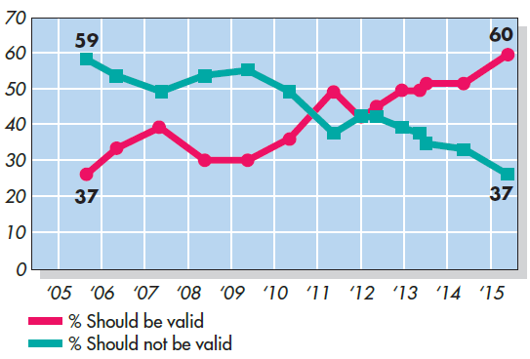
Changes in Attitudes Toward Same-Sex Marriage
Notes:
Figure 5.8 Changes in Attitudes Toward Same-Sex Marriage Opinion polls from 2004 to 2019 have shown that the percentage of Americans who say they support same-sex marriage has risen dramatically in recent years, showing a complete reversal in percentages. Based on Pew Research Center, 2019a.

Slide 24
Being Stigmatized
Stigmatized
  Being persistently stereotyped, perceived as deviant, and devalued in society because of membership in a particular social group or because of a particular characteristic.
The targets of stigmatizing stereotype frequently wonder whether and to what extent others’ impressions of them are distorted through the warped lens of social categorization.

Slide 25
Stereotype Threat
Stereotype threat
  The experience of concern about being evaluated based on negative stereotypes about one’s group
Effects on the intellectual performance and identity of its targets
  Increasing anxiety and triggering distracting thoughts
  Disidentify from that domain—to dismiss the domain as no longer relevant to their self-esteem and identity
A person does not have to believe in the stereotype to be affected by it.

Slide 26
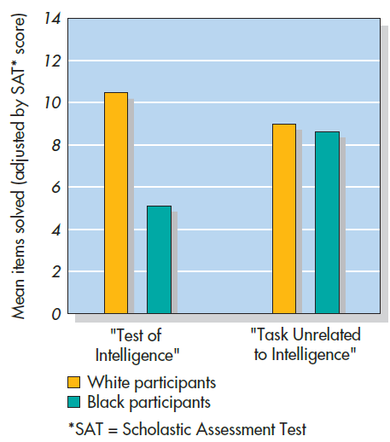
Notes:
Figure 5.9 Stereotype Threat and Academic Performance Black students did worse on a difficult verbal test than white students (even after the students’ scores were adjusted based on their performance on standardized college entrance verbal exams) if they had been told the test was of intellectual ability (left). In contrast, there was no difference in adjusted scores between black and white students on the same test if they had been told the test was unrelated to ability (right). Source: Based on Steele and Aronson, 1995.

Slide 27
Causes of Stereotype Threat Effects
Triggers physiological arousal and stress
Drains cognitive resources
Causes loss of focus to the task at hand because of attempts to suppress thoughts about the relevant stereotype

Slide 28
Social Categories and Intergroup Conflict
Social categorization
  The classification of persons into groups on the basis of common attributes.
In some ways, it is natural and adaptive.
  Save a lot of time and effort by using people’s group memberships to make inferences about them
Categorizing people leads us to overestimate the differences between groups and to underestimate the differences within groups.

Slide 29
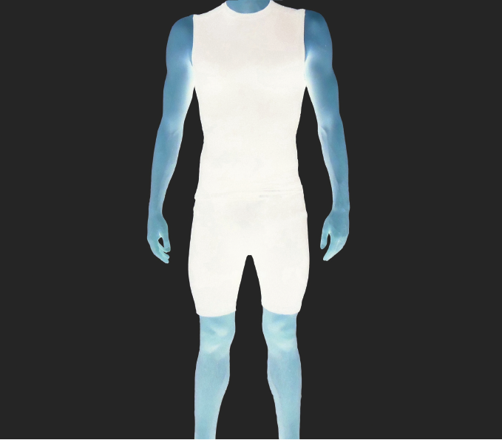
Racial Categorization and Perception of Size
Notes:
Figure 5.10 Racial Categorization and Perception of Size Participants in studies by John Paul Wilson and others (2017) saw images like this, in which the race of the man depicted could not be determined. If the participants were led to believe the man was racially black, they estimated that he was taller and weighed more than if they were thought he was white. From Wilson et al. (2017)

Slide 30
Ingroups Versus Outgroups (1 of 2)
Perceivers themselves are members or nonmembers of the categories they use
Consequences
  Exaggerate the differences between our ingroups and other outgroups
  Help to form and reinforce stereotypes
  Outgroup homogeneity effect (all outgroup members are the same)

Slide 31
Ingroups Versus Outgroups (2 of 2)
Why do people tend to perceive outgroups as homogeneous?
  Less personal contact and familiarity with individual members of outgroups
As soon as we categorize an unfamiliar person as a member of our ingroup or an outgroup, we immediately process information about them differently at even the most basic levels

Slide 32
Dehumanizing Outgroups
People may not only process outgroup faces more superficially but also sometimes process them more like objects and lower-order animals than like fellow humans.
Dehumanization has played a role in atrocities throughout history.
  Examples: The Holocaust, Rwandan Genocide, etc.

Slide 33
Reduced Empathy for Outgroup Members
People show patterns of brain activity associated with the experience of real pain when they see someone else apparently in pain.
A relatively automatic reaction, people tend to show much less of it when they see an outgroup member—or someone they are led to believe is an outgroup member—experience the pain.

Slide 34
Fundamental Motives Between Groups
A fundamental motive to protect one’s ingroup and be suspicious of outgroups is therefore likely to have evolved.
  Basic motivations of self-protection are activated
  More prone to exhibit prejudice toward outgroups
Flip side: Positive feeling we have toward being part of an ingroup
  Enhances our sense of control and meaning
  Survival!

Slide 35
Motives Concerning Intergroup Dominance and Status
Social dominance orientation
  Desire to see one’s ingroup as dominant over other groups and a willingness to adopt cultural values that facilitate oppression over other groups
  Social dominance orientations promote self-interest.
System justification theory
  People are motivated (at least in part) to defend and justify the existing social, political, and economic conditions.
  Protects the status quo

Slide 36
Realistic Conflict Theory
Direct competition for valuable but limited resources breeds hostility between groups
  Example: land, jobs, power
  “Realistic” competition for resources may be imagined—a perception in the mind of an individual who is not engaged in any real conflict.
Relative deprivation
  Feelings of discontent aroused by the belief that one fares poorly compared with others

Slide 37
Social Identity Theory (1 of 2)
Each of us strives to enhance our self esteem, which has two components:
  A personal identity
  Various collective or social identities that are based on the groups to which we belong
Threats to self-esteem heighten the need for ingroup favoritism
Expressions of ingroup favoritism enhance one’s self-esteem

Slide 38
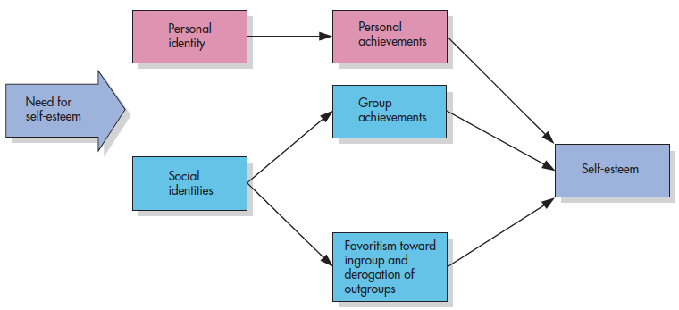
Social Identity Theory (2 of 2)
Notes:
Figure 5.12 Social Identity Theory According to social identity theory, people strive to enhance self-esteem, which has two components: a personal identity and various social identities that derive from the groups to which we belong. Thus, people may boost their self-esteem by viewing their ingroups more favorably than outgroups.

Slide 39
Culture and Social Identity
Collectivists
  Value connectedness and interdependence with people and groups around them
  Tie personal identity closely to social identity
  Show some biases favoring their ingroups, but less likely to enhance their ingroups to boost their own self-esteem
  May draw sharper distinctions between ingroup and outgroup members than individualists do
  Tend to have a narrower circle of people they trust

Slide 40
Culture and Socialization
Socialization
  Processes by which people learn the norms, rules, and information of a culture or group
  Includes stereotypes, how valued or devalued various groups are, and which prejudices are acceptable to have
  More generally, the stereotypes and prejudices exhibited by peers, media, and one’s culture are part of the air each of us breathes as we develop, and these influences can be profound

Slide 41
What Mothers Would Say
Context of Statement | Frequency of Statement by Mothers of Girls | Frequency of Statement by Mothers of Boys
Caution | 3.9 | 0.7
Worry about injury | 9.2 | 0.2
Directive to stop | 9.3 | 0.6
Encouragement | 0.5 | 3.0
Notes:
Table 5.1 What Mothers Would Say Mothers of young boys or girls watched a video of another child engaging in somewhat risky behavior on a playground. The mothers were instructed to stop the video whenever they would say something to the child if the child were theirs and to indicate what they would say. Mothers of daughters stopped the video much more often than mothers of sons to express caution (“Be careful!”), worry about injury (“You could fall!”), and directives to stop (“Stop that this instant!”). In contrast, mothers of sons were more likely to indicate encouragement (“Good job! Let me see you go higher!”).
Adapted from Morrongiello & Dawber, 2000.

Slide 42
Social Role Theory
Sex differences are magnified by the unequal social roles that men and women occupy.
  The process involves three steps:
    A division of labor between the sexes emerged over time both at home and in the work setting.
    People behave in ways that fit the roles they play, and men are more likely than women to wield physical, social, and economic power.
    Behavioral differences contribute perception of men as dominant and women as domestic “by nature”

Slide 43
Stereotype Content Model
Stereotype content model
  A model proposing that the relative status and competition between groups influence group stereotypes along the dimensions of competence and warmth.
Groups may be considered high on both dimensions, low on both, or high on one dimension but low on the other.

Slide 44
Media Effects
Pervasive media images have the potential to perpetuate stereotypes and discrimination.
Media depictions can influence viewers, often without the viewers realizing it.
Media can influence current health and behavioral concerns.

Slide 45
How Stereotypes Distort Perceptions and Resist Change
Confirmation bias and self-fulfilling prophecies
  People’s tendencies to interpret, seek, and create information that seems to confirm expectations
  False expectations about a person cause the person to behave in ways that confirm those expectations
Attributions and subtyping
  Explain the causes of others’ behaviors
  Perceivers can more easily maintain their stereotypes of these groups

Slide 46
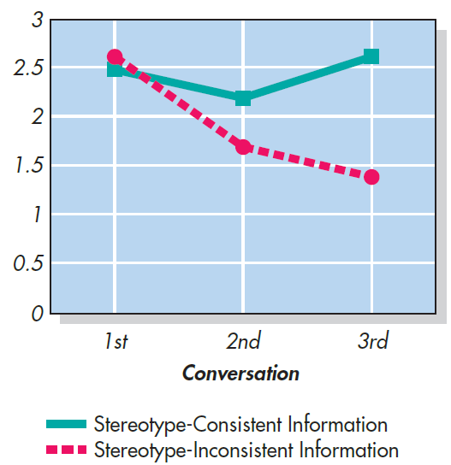
Stereotype Confirmation via Communication
Notes:
Figure 5.14 Stereotype Confirmation via Communication Australian students read a story about an Australian Rules Football player who behaved in ways both consistent and inconsistent with stereotypes about such players. Each student who read the story then had to orally tell another student as much as he or she could remember about the story, who then in turn told a third student, who in turn told a fourth. Although the first student told both stereotype-consistent and inconsistent details, by the time of the final telling of the story, more of the stereotype-inconsistent details dropped out, making the player sound much more stereotypic than he was. Kashima et al., 2013.

Slide 47
Automatic Stereotype Activation (1 of 2)
Stereotypes can:
  Be activated in our minds without our awareness
  Influence subsequent thoughts, feelings, and behaviors even in perceivers who are relatively low in prejudice

Slide 48
Automatic Stereotype Activation (2 of 2)
Factors can make such activation more or less likely to happen.
  Prevalent than others in a particular culture
  How prejudiced the perceiver is
  Motivation to protect self-esteem
  Intrinsic motivation to avoid applying stereotypes

Slide 49
Intergroup Contact (1 of 2)
Allport’s contact hypothesis
  Direct contact between hostile groups will reduce intergroup prejudice under certain conditions.
Brown v. Board of Education of Topeka (1954)
  Racially separate schools were inherently unequal and violated the U.S. Constitution
  Contact between black and white students did not have the intended effect on intergroup attitudes
  Four conditions are ideal for contact to succeed

Slide 50
The Contact Hypothesis: Conditions
Four conditions are deemed ideal for intergroup contact to serve as a treatment for racism.
Equal status. The contact should occur in circumstances that give the two groups equal status.
Personal interaction. The contact should involve one-on-one interactions among individual members of the two groups.
Cooperative activities. Members of the two groups should join together in an effort to achieve superordinate goals.
Social norms. The social norms, defined in part by relevant authorities, should favor intergroup contact.
Notes:
Table 5.2 The Contact Hypothesis: Conditions

Slide 51
Intergroup Contact (2 of 2)
Pettigrew and Tropp (2000, 2006, 2008) found reliable support for benefits of intergroup contact in reducing prejudice by:
  Enhancing knowledge about the outgroup
  Reducing anxiety about intergroup contact
  Increasing empathy and perspective taking

Slide 52
Intergroup Friendships and Extended Contact
Friendships across groups is one of the best ways to experience many optimal contact conditions
  Equal status
  Meaningful one-on-one interactions that extend across time and settings
  Cooperation toward shared goals
Having a friend with a cross-group friendship can reduce a person’s ignorance and anxiety.

Slide 53
Shared Identities (1 of 2)
Common Ingroup Identity Model
  If members of different groups recategorize themselves as members of a more inclusive superordinate group, intergroup attitudes and relations can improve.

Slide 54
Shared Identities (2 of 2)
  Recognizing shared categorization allows creation of a common ingroup identity
    Individuals from minority groups or groups that have less power in society may feel positively as majority group members do about recategorizing their groups into one common ingroup; these groups sometimes prefer or benefit more from dual-identity.

Slide 55
Trust, Belonging, and Reducing Stereotype Threat
Small changes in situational factors that give rise to stereotype threat
Successful interventions
  Individuals feel a sense of trust and safety in the situation
  Reduce feelings of uncertainty about belonging

Slide 56
Exerting Self-Control (1 of 2)
Trying to suppress stereotyping or control prejudiced actions can take mental effort
Being physically tired can sap perceivers of the cognitive resources necessary to avoid stereotyping.
Galen Bodenhausen (1990): experiment with two types of people:
  “morning people” (most alert early in the morning)
  “night people” (peak much later, in the evening)

Slide 57
Exerting Self-Control (2 of 2)
Motivation to control prejudice
  Externally driven—not wanting to appear to others to be prejudiced
  Internally driven—not wanting to be prejudiced
    More likely to be successful at controlling stereotyping and prejudice
    Are vulnerable to strong power of automatic stereotyping and implicit biases
    More likely to be influenced by antiprejudice messages that appeal to internal motivations than external motivations

Slide 58
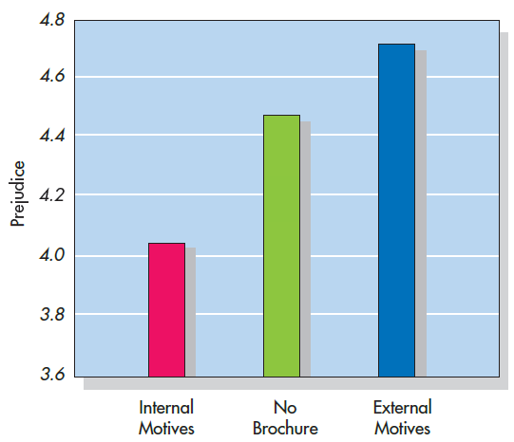
Productive and Counterproductive Antiprejudice Messages
Notes:
Figure 5.17 Productive and Counterproductive Antiprejudice Messages Compared to students who did not receive any brochure, those who read an antiprejudice brochure that emphasized internally driven motivations to not be prejudiced (such as why one would benefit by promoting diversity) later exhibited significantly less prejudice toward black people. In contrast, students who received the brochure that appealed to external factors (such as how one could get in trouble if caught doing or saying something racist) exhibited significantly more prejudice. From Legault et al., 2012.

Slide 59
Changing Cognitions, Cultures, and Motivations
Social-cognitive methods can help reduce stereotyping and prejudice.
Exposure to images and individuals that reflect diversity within social groups.
Motivations, norms, and values change over time, often as a result of changes in popular culture.
Peer influence can change sense of norms.

